Slide 1
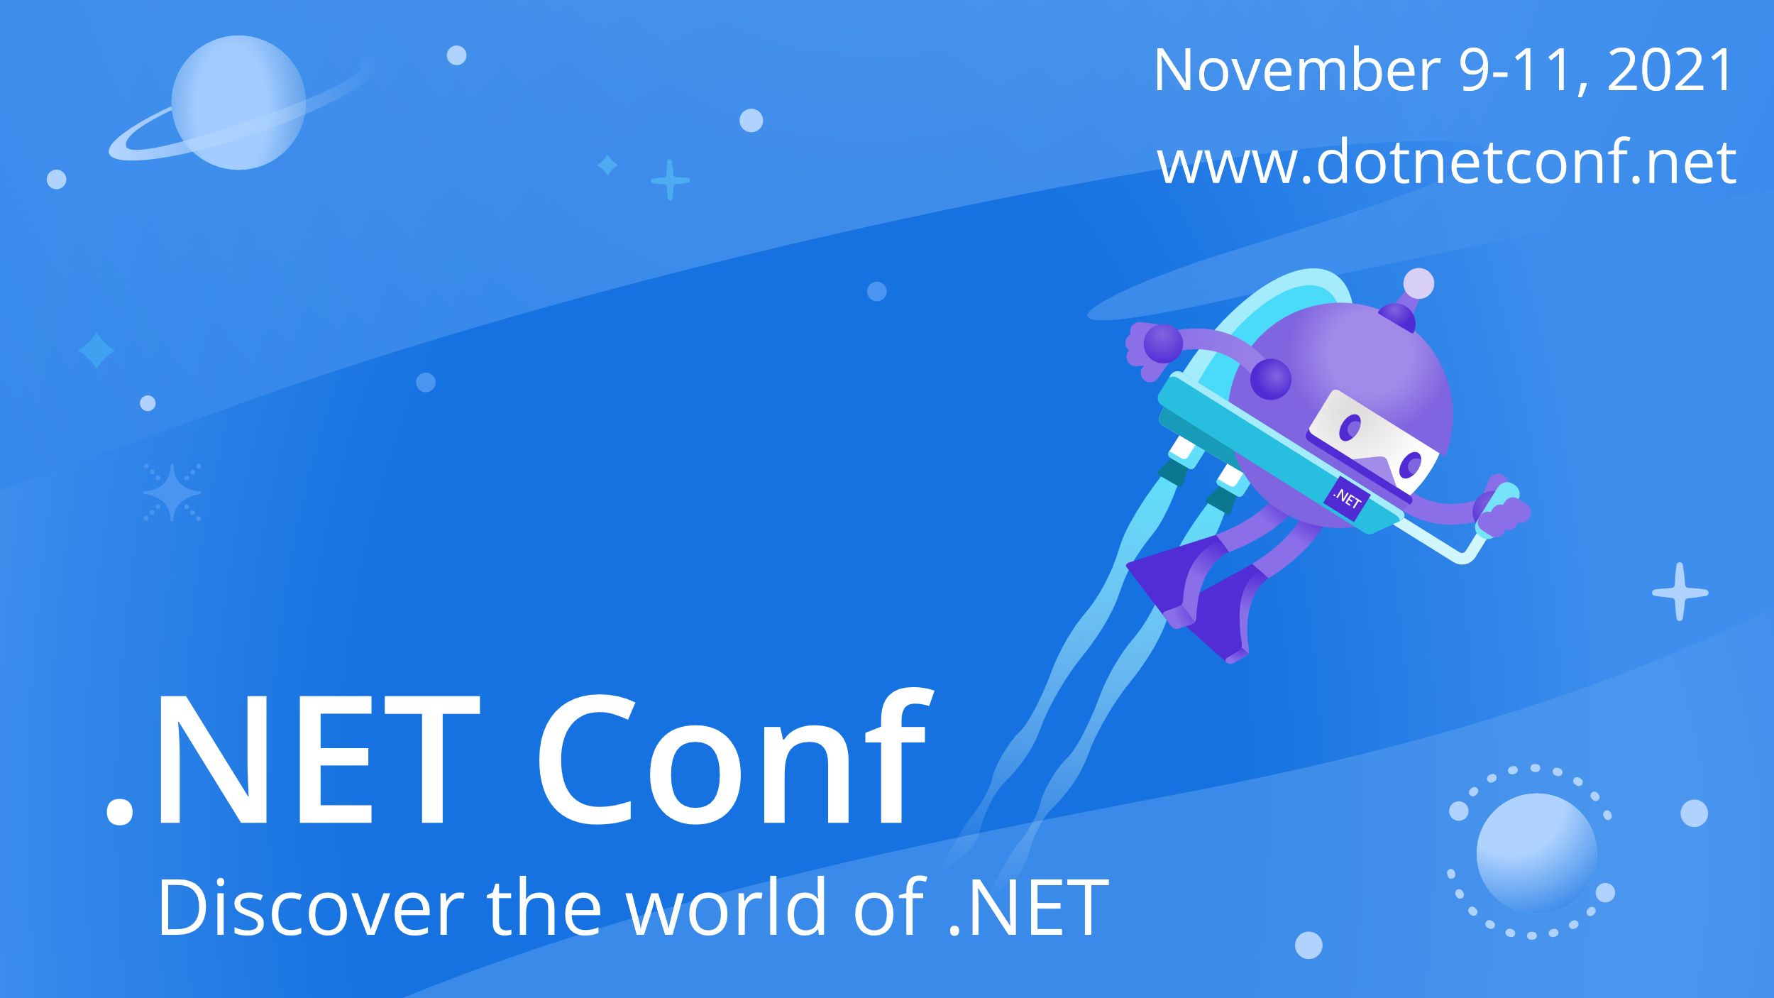

Slide 2


Creating NFT with .NET
Sebastián Leonardo Pérez
@sebaleoperez

Slide 3
Blockchain

Slide 4
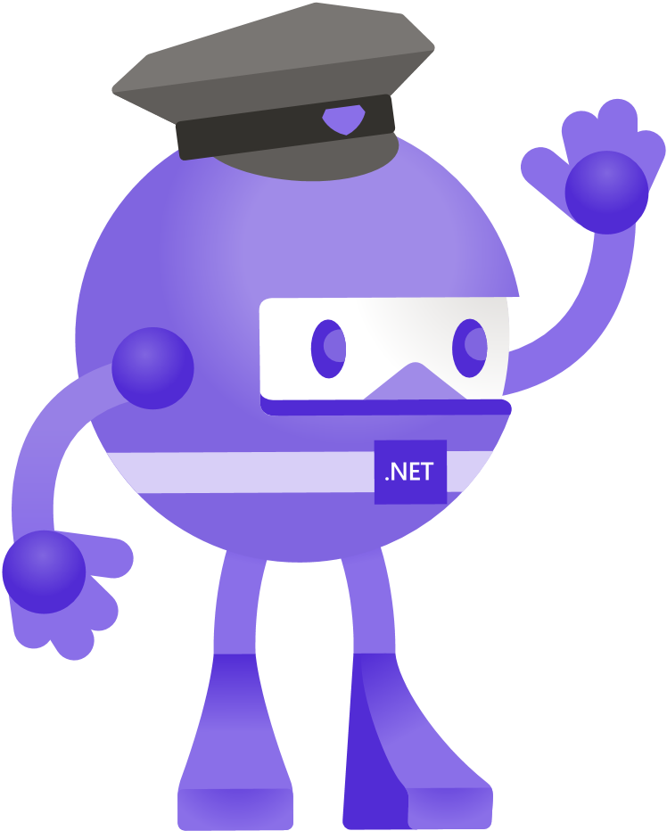
Blockchain
Security

Slide 5
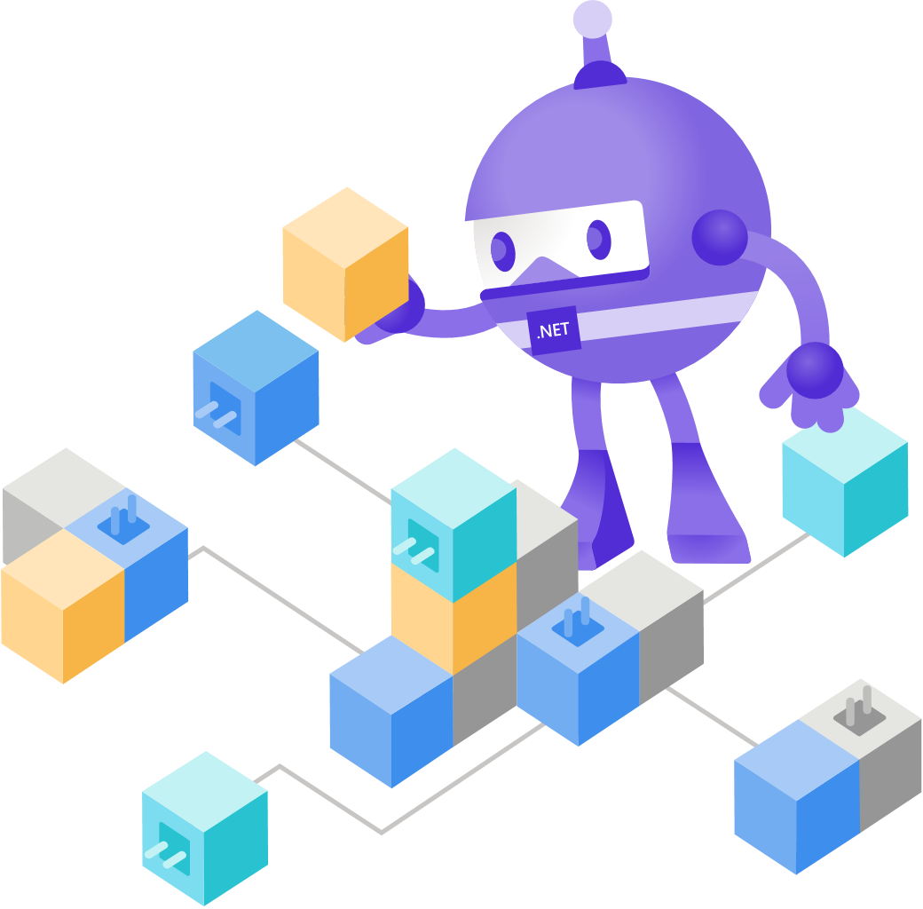
Blockchain
Security
Distributed storage

Slide 6

Blockchain
Security
Distributed storage
Tamper-proof

Slide 7

Blockchain
Security
Distributed storage
Tamper-proof
Trust / Consensus

Slide 8

Blockchain
Security
Distributed storage
Tamper-proof
Trust / Consensus
Decentralization

Slide 9





Token

Slide 10


Token Categories
Fungible
Spendable
Replaceable
Same value
Non-Fungible
Not spendable
Unique
Different value

Slide 11
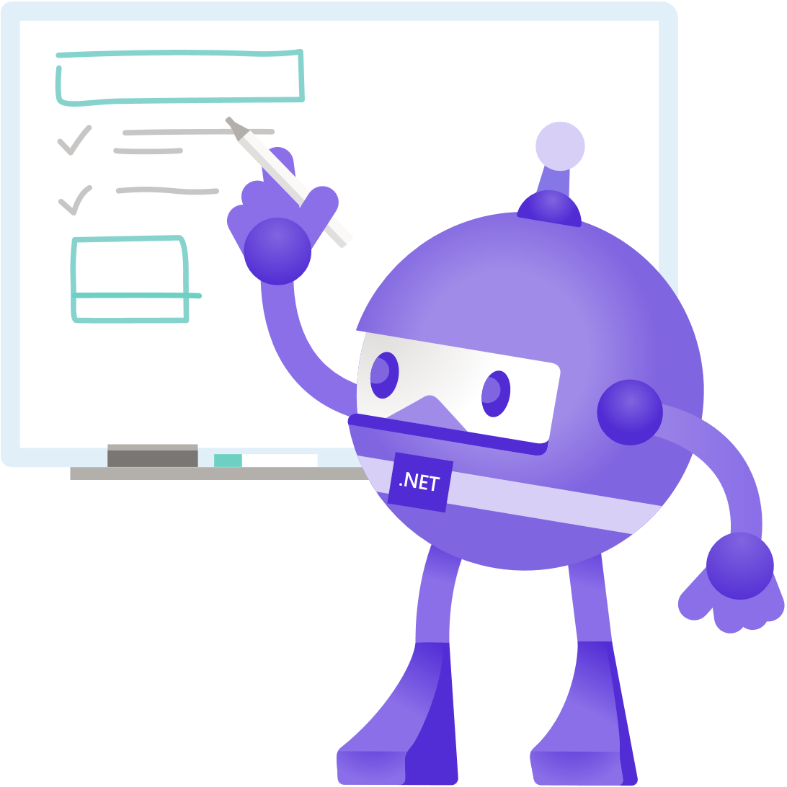
Smart Contracts
Piece of code stored and executed in the blockchain
Similar to an agreement
Not really code… bytecode

Slide 12


Nethereum
Open-Source .NET integration library for blockchain
Available in NuGet
Templates for NFT (ERC 721)

Slide 13
Demo
Let’s create a NFT with Nethereum

Slide 14
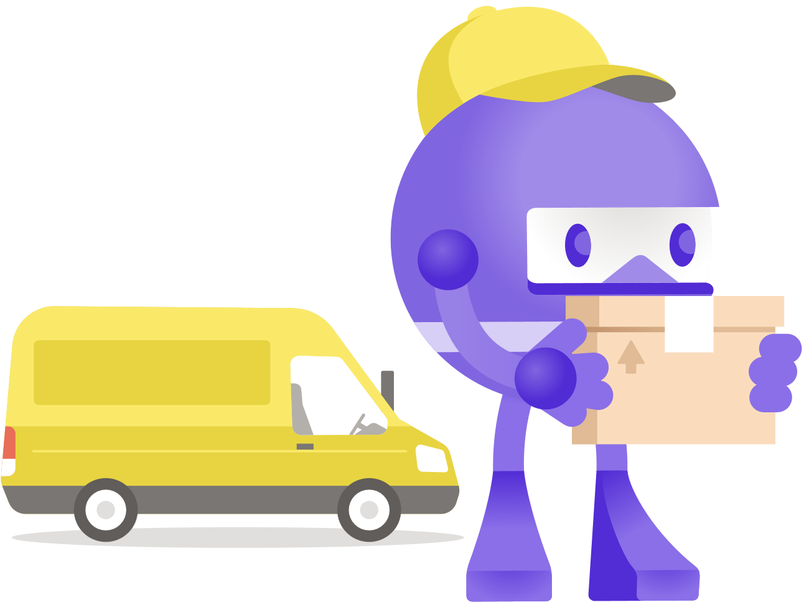
Use cases for NFT
Collectibles
Sports
Arts
Gaming

Slide 15

Learn more
Nethereum Documentation: https://docs.nethereum.com/
Nethereum Playground: http://playground.nethereum.com/
Source code and samples: https://github.com/Nethereum

Slide 16
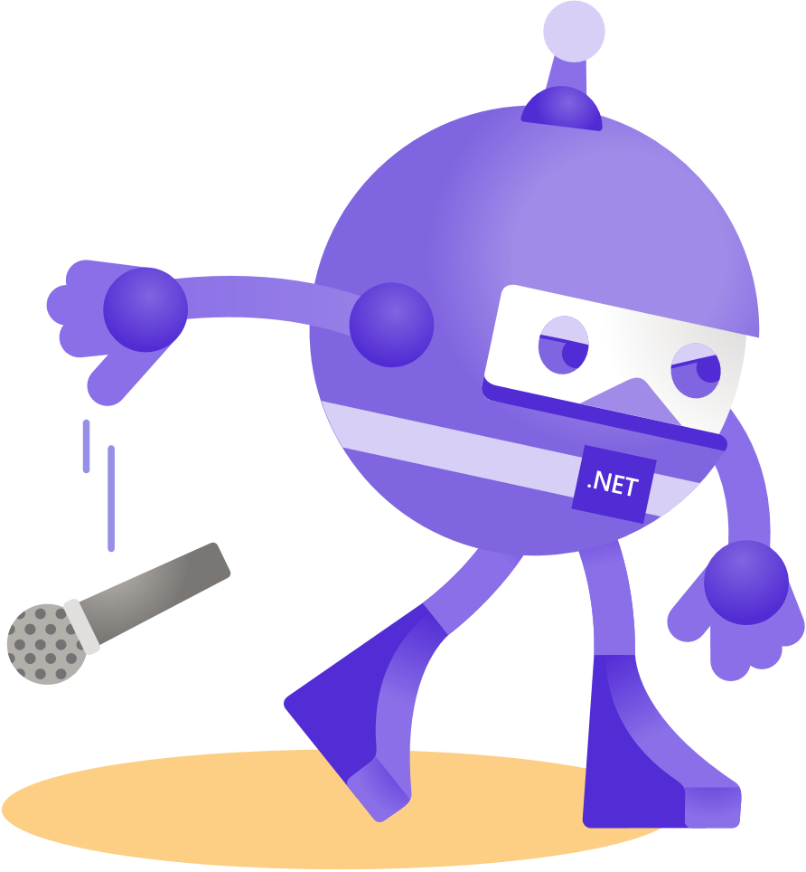
Thanks for joining!
Sebastián Leonardo Pérez
@sebaleoperez

